Slide 1
Queries in a Data Base
Gr 11 and Gr 12

Slide 2
Queries
The function of a query is to extract information from a data base.
You will seldom have to create a query but you will have to build up on an existing one.

Slide 3
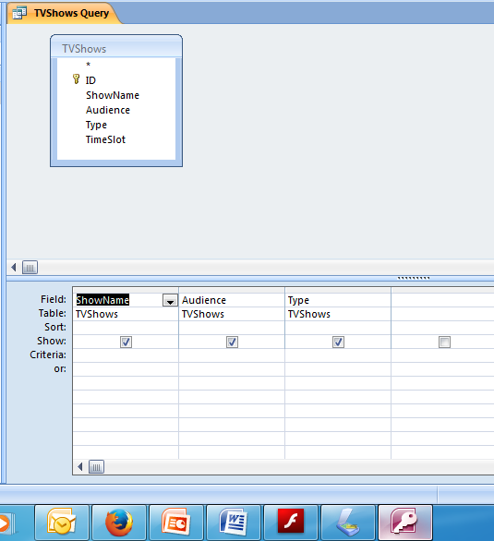
Typical Query Screen
Fields in the
Table – not all
need to be
selected for
the query
Selected fields from TV Shows table
Can do an ascending or descending sort
Can choose whether the field will be
shown
Can add Criteria

Slide 4
Criteria

Slide 5
Criteria
A criteria can be simple – one word (e.g. Comedy for Type) in which case only records that fit that word will be shown.
Using the table on the previous screen we can make the criteria tighter. E.g. under type we could use LIKE “C*” this would give us comedy as well as crime shows.

Slide 6
Criteria (2)
We can fill in more than one criteria on the criteria line. Any criteria on the criteria line will be viewed as AND. In other words a show has to fulfil both criteria in order to show.
If we fill in a criteria in the OR line records falling into either one will show.
If we use NOT that criteria will be excluded.

Slide 7
In the first example ONLY comedies for mature audiences will be displayed
In the second example ALL comedies and ALL shows for mature audiences will be displayed

Slide 8
Calculations in Queries
Grade 12 ONLY
When you are asked to do a calculation in a query you use the next available space:
In this example it is the empty field after Type

Slide 9
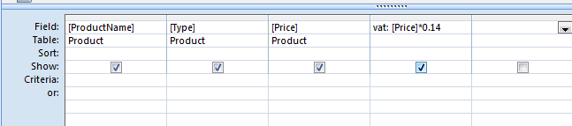
In this query you are required to calculate the vat payable on each product.
The last field in the table is Price.
Click in the next space to enter the calculation.
The calculation must have a name and refer to the field that will be used and the calculation
VAT:[Price]*0.14
The name of the new field
The Calculation
Colon NOT
Equals
The name of the field needed for the calculation – note brackets

